Slide 1
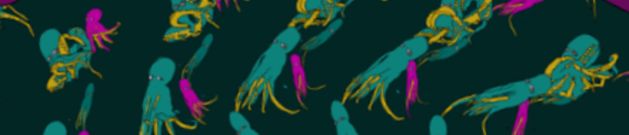
Ultra-Hi Definition Real Time Zoetrope
Nomso Ashiogwu, Daniel Cleaver, Mick Harrigan, Christian Lostoski
Notes:
All

Slide 2
Project Description
Interactive art installation
Rotate image at correct speed
Audio
Deliverables
UHDRTZ System
User/Setup Guide
Maintenance Interface
https://vimeo.com/192471992
Notes:
mick

Slide 3
Project Requirements
4K input and output (3840 x 2160)
Music output
Haptic
Rotary encoder crank
Crank feedback feels like DC motor
User interface
Sizing
Zoom
Position
Image processing
Color, Hue, Etc.
Notes:
Christian - Mention new requirement

Slide 4
GEECS
Global: not relevant
Environmental: We have thought of how this would be used in an Art museum with different age groups of people mainly children when analyzing how to fix our crank
Economic: not relevant
Cultural: You get to have different groups of people analyze pieces of still art in motion from different artists
Social: not relevant
Notes:
nomso

Slide 5
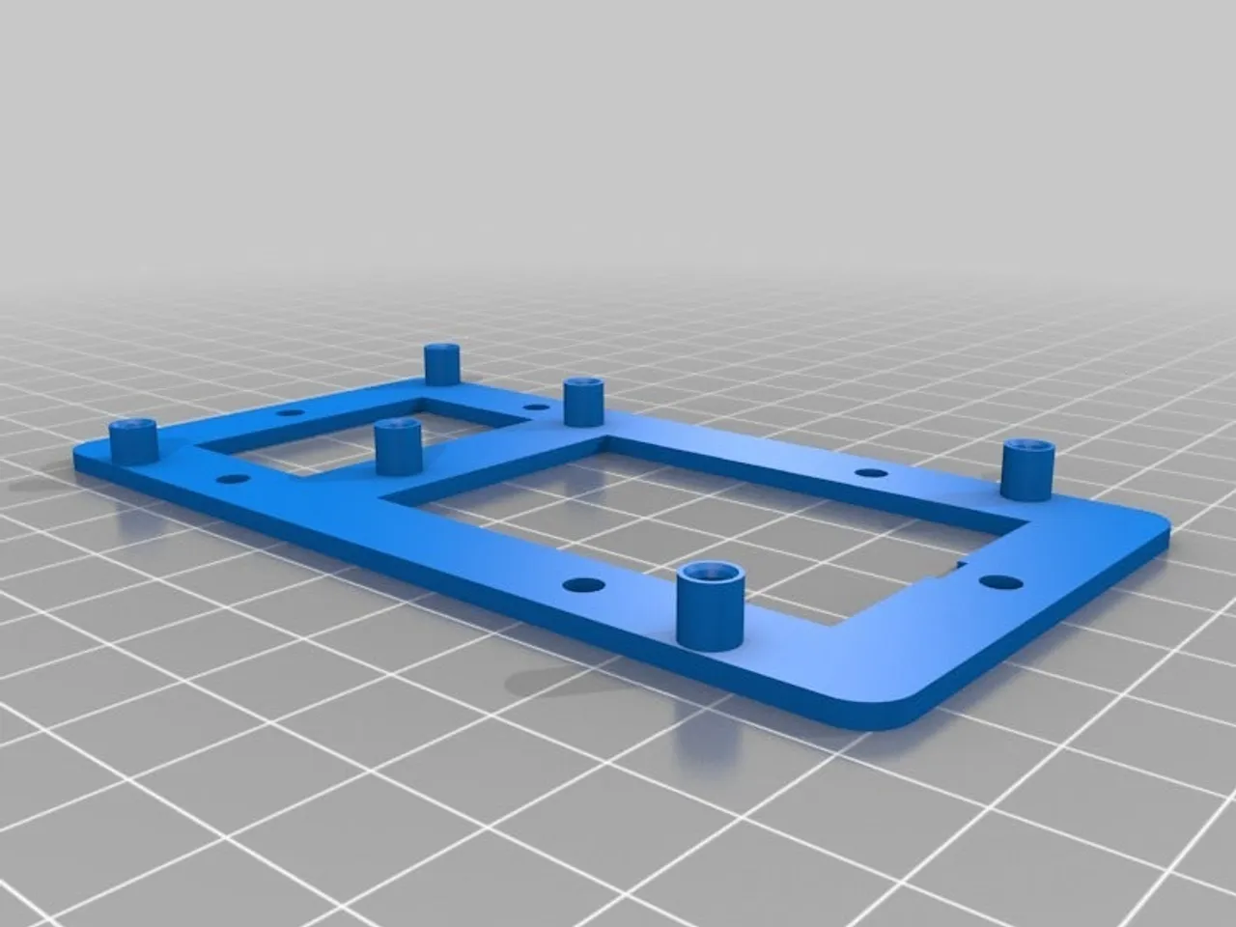
Preliminary Design
4K operating successfully
Rotary Encoder operating successfully
Start on boot
Program starts in the background
Won’t open up in the foreground
SSH
Port-forwarding issue
Design decision changes
Arduino Mounting
Haptics for crank
Notes:
Christian

Slide 6
Interface Identification
External Interfaces
Human -> Crank
Crank -> Rotary encoder
Encoder -> Arduino
Arduino -> FPGA
Camera -> FPGA
FPGA -> Projector
AC Power -> FPGA
AC Power -> Arduino
Projector -> Human
Notes:
mick

Slide 7
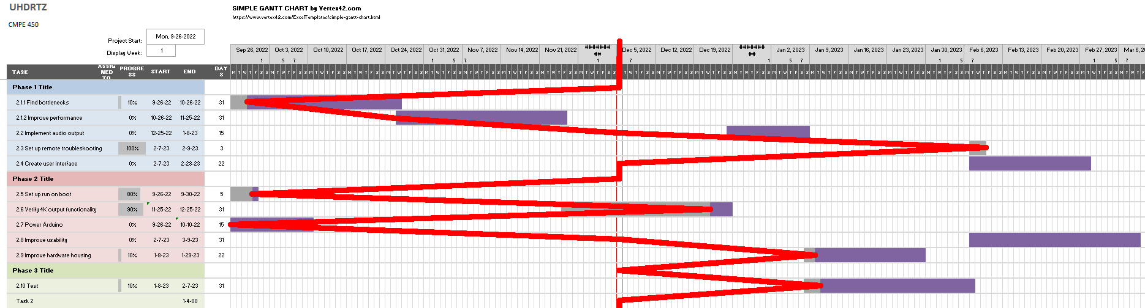
Development Schedule and Status
Notes:
dan

Slide 8
Demo Plans
Demo on the 14th at 10:30
What we are ready to show
Operating rotary encoder crank
4K output
Notes:
dan

Slide 9
Whats Next?
Audio Output
Run on Boot
System Bottlenecks
User Guide
Power Arduino
Physical Plates for Arduino
Crank Haptics
Image Processing

Slide 10
Questions?
Thank you for your time

